Slide 1

Bond 2020
Community Update
Rhodes Middle School
Carvajal Elementary School
April 22, 2025

Slide 2

Purpose of Today’s Meeting
Bond 2020 Program Update
Major renovation updates for:
Rhodes Middle School
Carvajal Elementary
Facility Condition Assessment and master planning

Slide 3
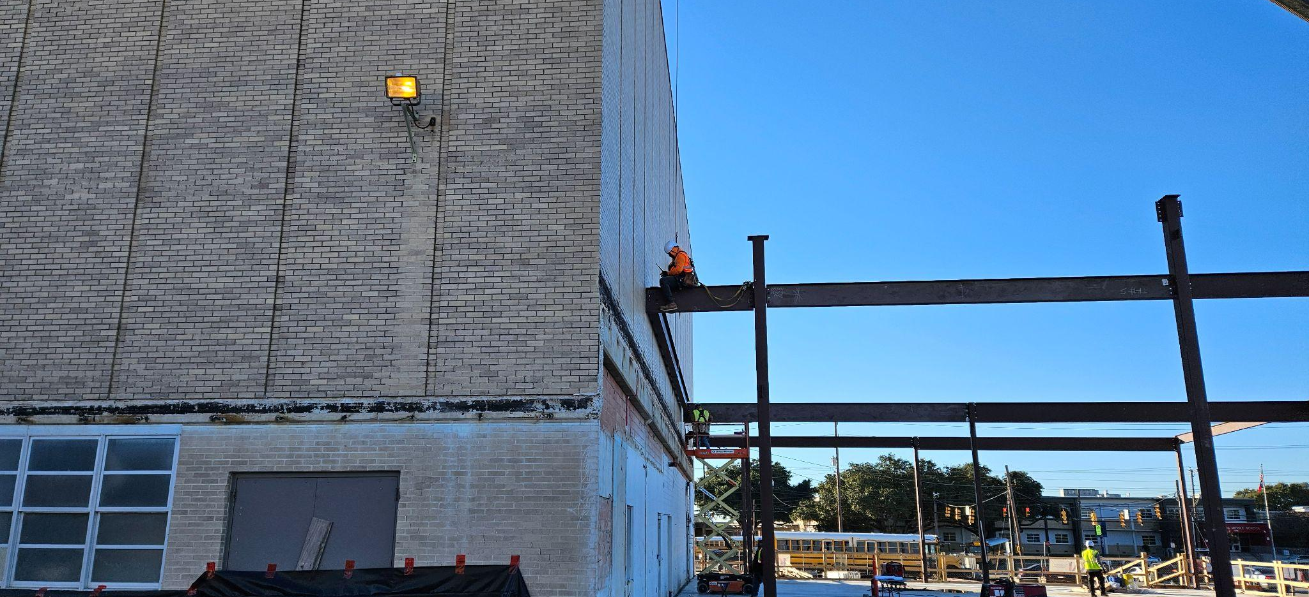
Bond 2020 Planning
Renovation projects were planned pre-pandemic using standard estimates
of 4%-5% for inflation

Slide 4
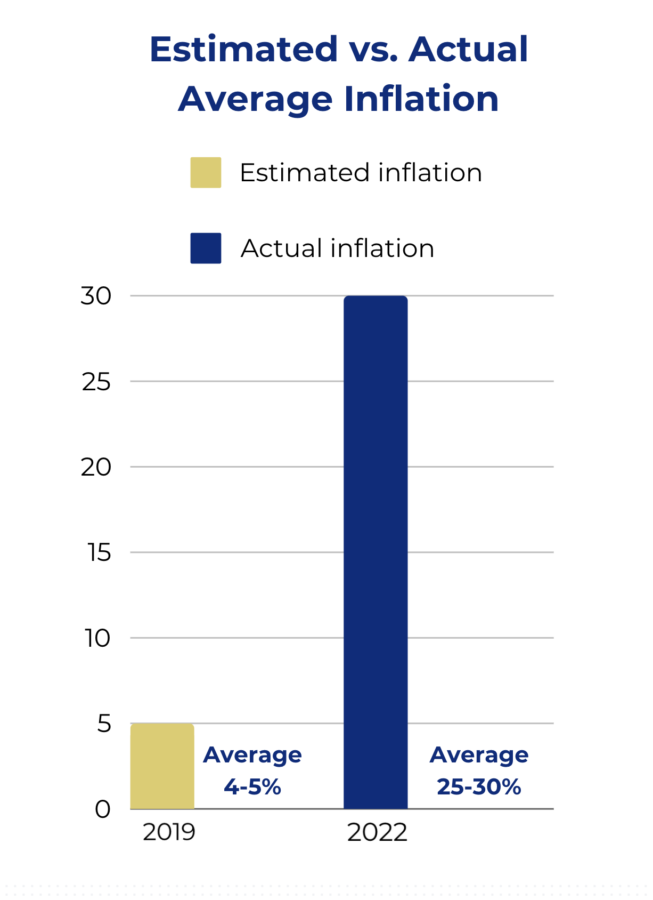
Pandemic Impacts
And then the global pandemic
hit, bringing with it significant construction pressures:
Unprecedented inflation
Average of 25-30%
Preliminary estimates for all projects came in over budget
Supply chain issues
Labor shortages

Slide 5
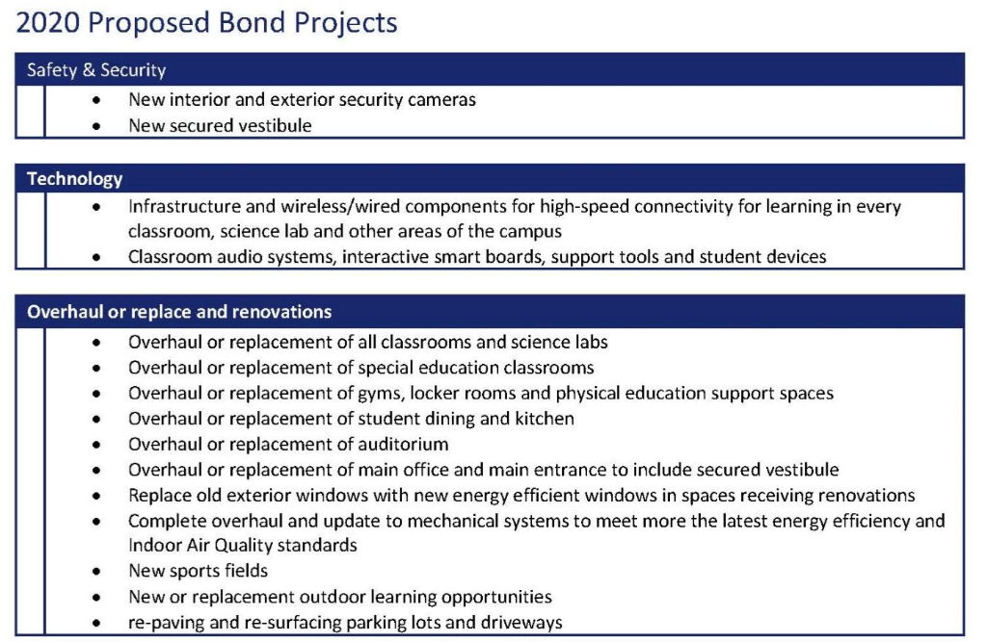
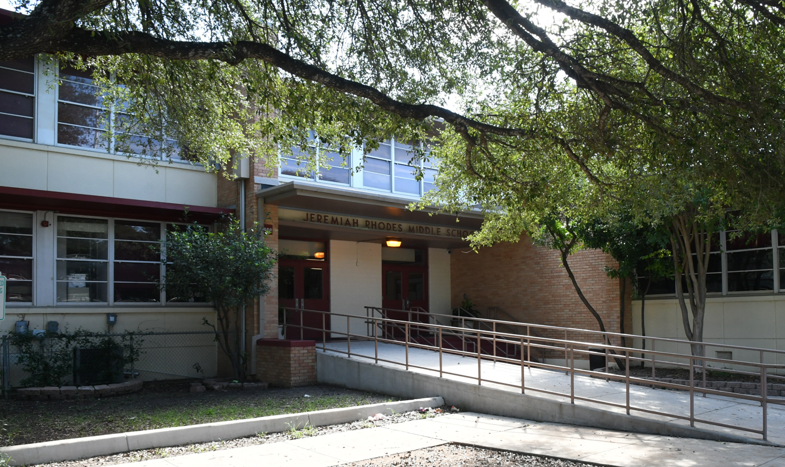
Rhodes MS: Project Goal
Total Budget: $47.5M
Construction Budget: $35.6M

Slide 6
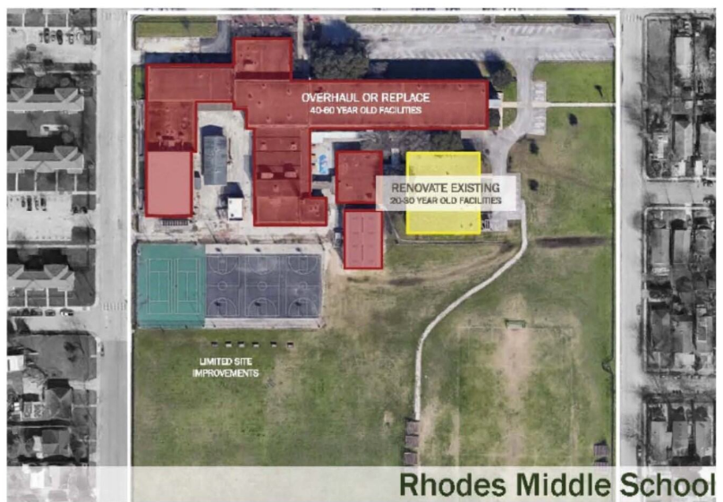

Rhodes MS: Current Information
Current Construction Estimate: $ 54.8 million = $19 million over
Facility Condition Index (FCI): Estimated 58% (more than 80% of the facility needs a major overhaul)
Educational Adequacy Index (EAI): Pending Data
Current Enrollment/Capacity:
453/717

Slide 7
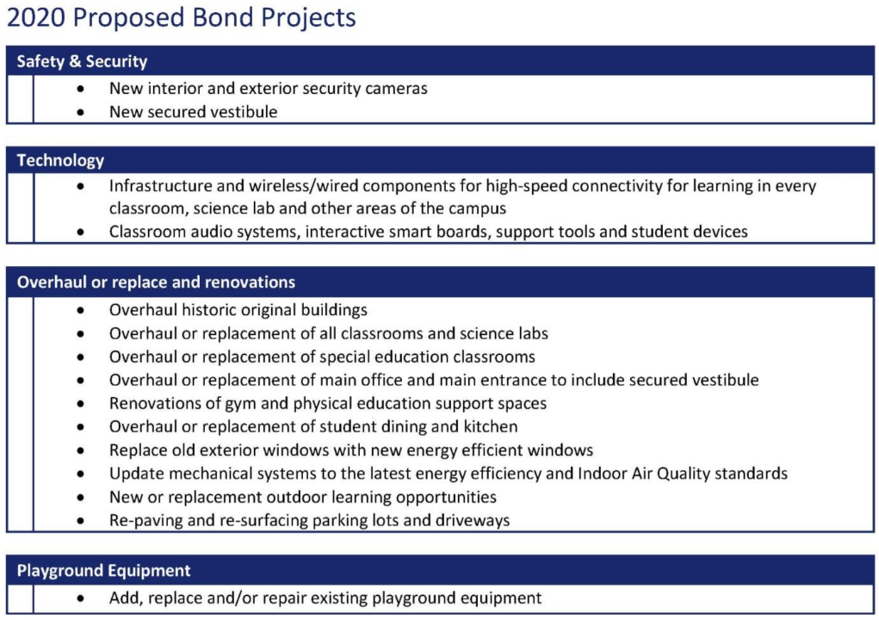
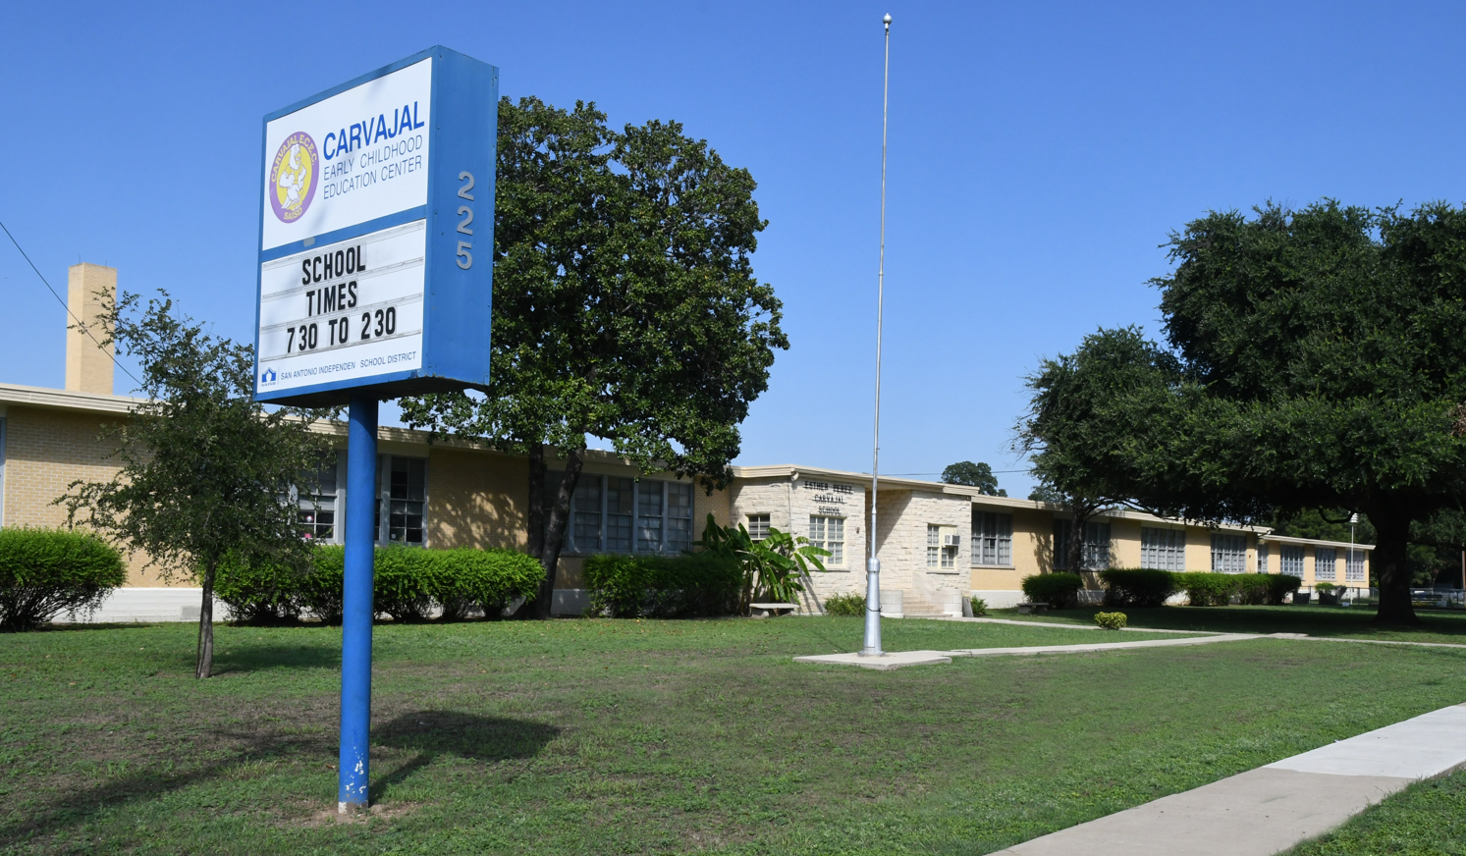
Carvajal ES: Project Goal
Total Budget: $28.6M
Construction Budget: 21.4M

Slide 8
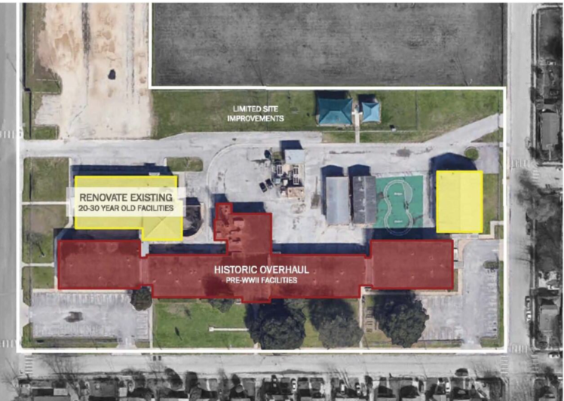

Carvajal ES: Current Information
Construction Estimate: $43.2 million = $ 21.7million over
Facility Condition Index: 43.39%
Educational Adequacy Index: 59.72%
Current Enrollment/Capacity: 346/537

Slide 9
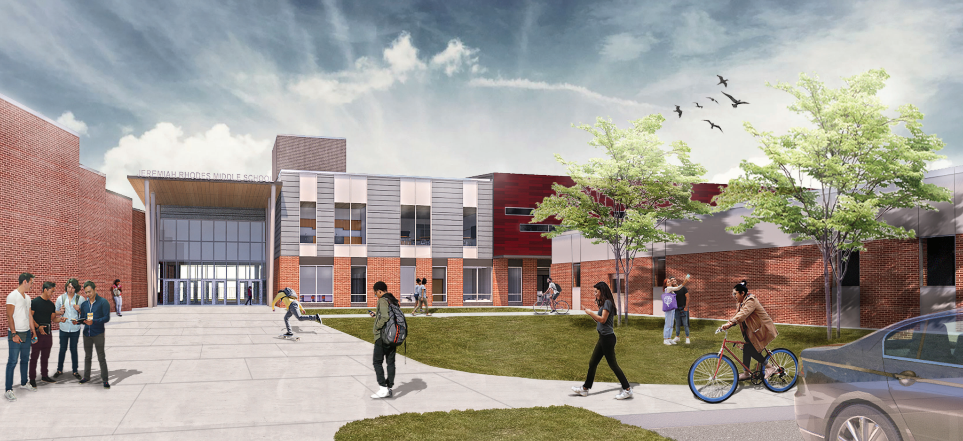

Reimagined Opportunities
Transition Carvajal to a nearby elementary with better facility conditions providing an opportunity to fully rebuild Rhodes into a state of the art traditional middle school.

Slide 10

Questions

Slide 11

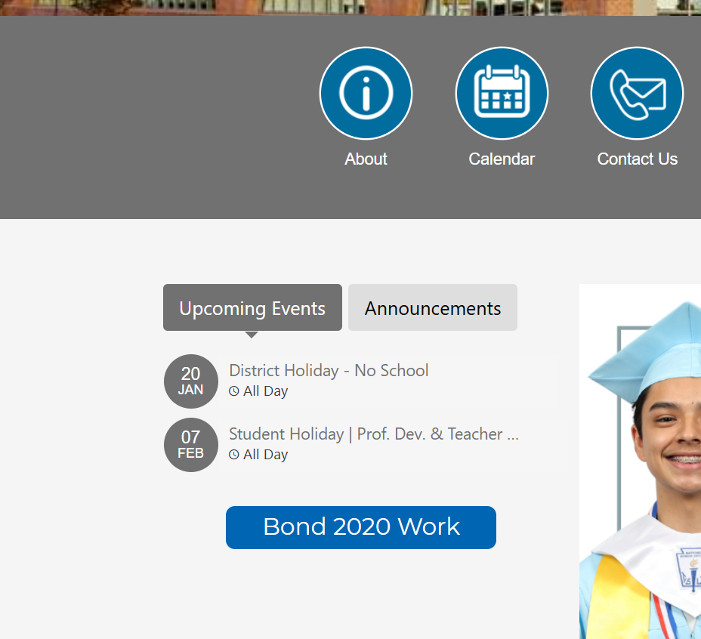




Bond Update & News
Bond.saisd.net For individual project updates, upcoming events, and more
Campus website Quick link to your school’s bond page via your campus homepage
Social media Follow SanAntonioISD on FB, Instagram, and LinkedIn for bond progress and event info

